Slide 1
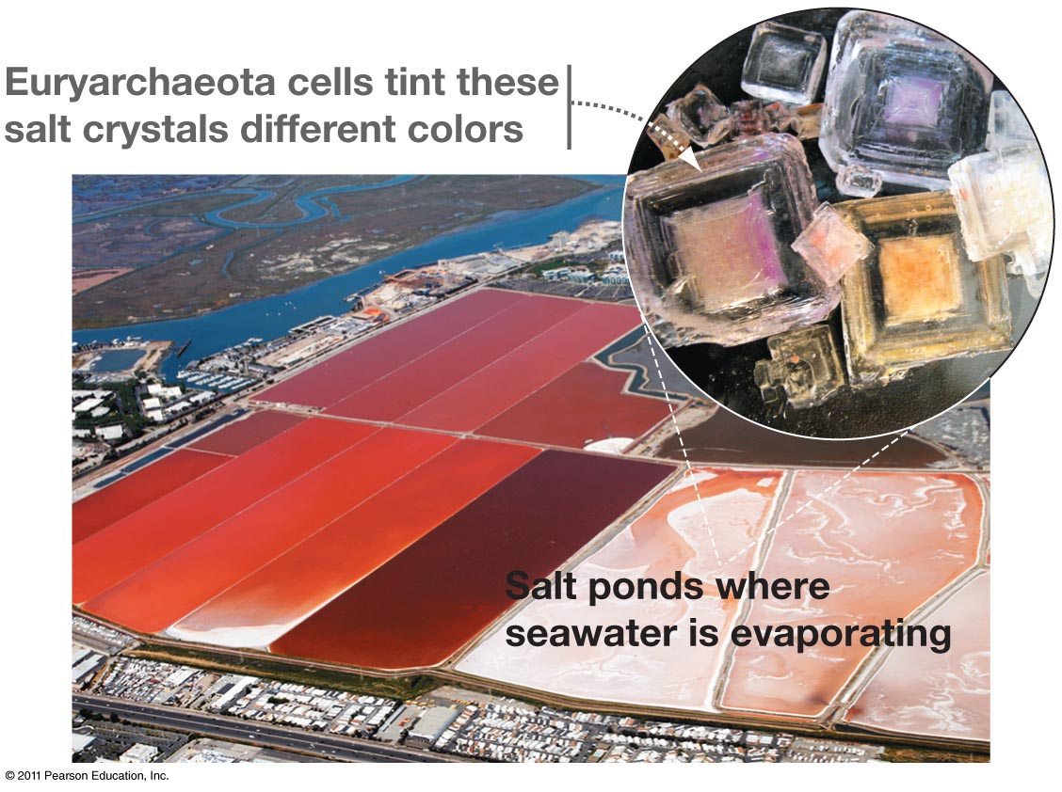
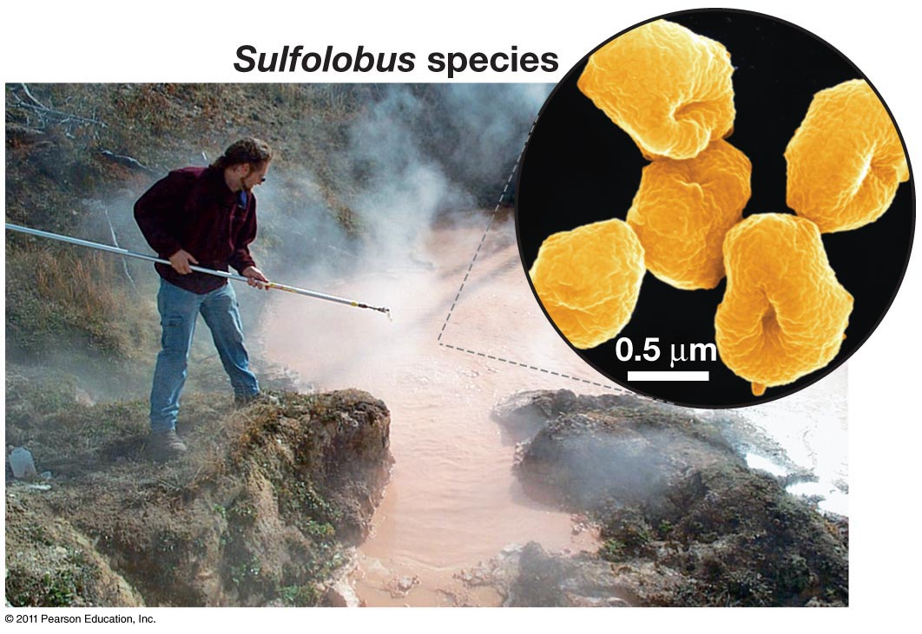
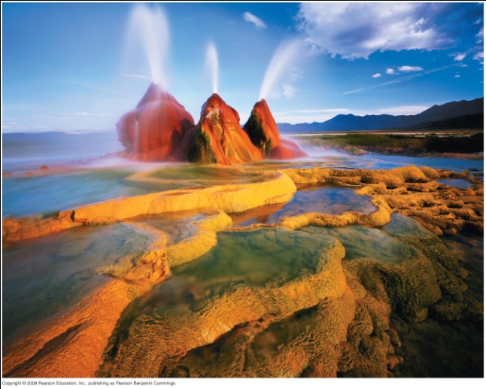
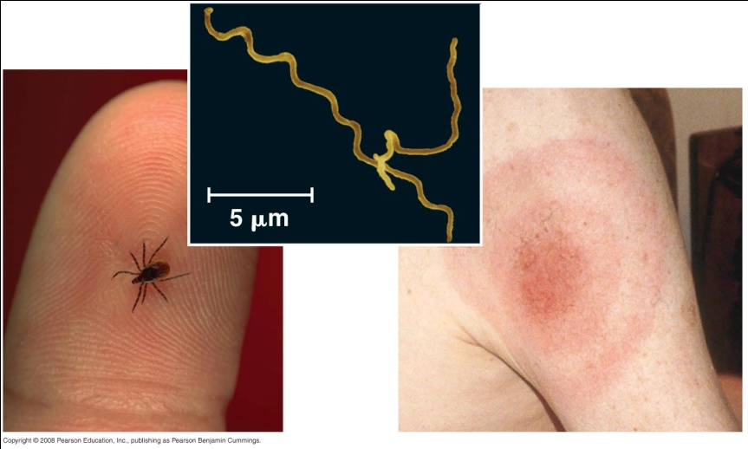
Modern Prokaryotes
Pro = without, lacking karyon = nut, kernel (i.e. nucleus)
Notes:
Unicellular. Found in nearly every environment. Teaspoon of saltwater contains population equivalent to large human city. Most cells in human body are bacteria and archaea, > by factor 10 fold.

Slide 2
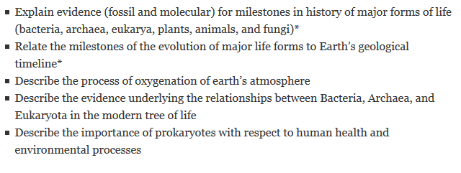
Learning Objectives

Slide 3
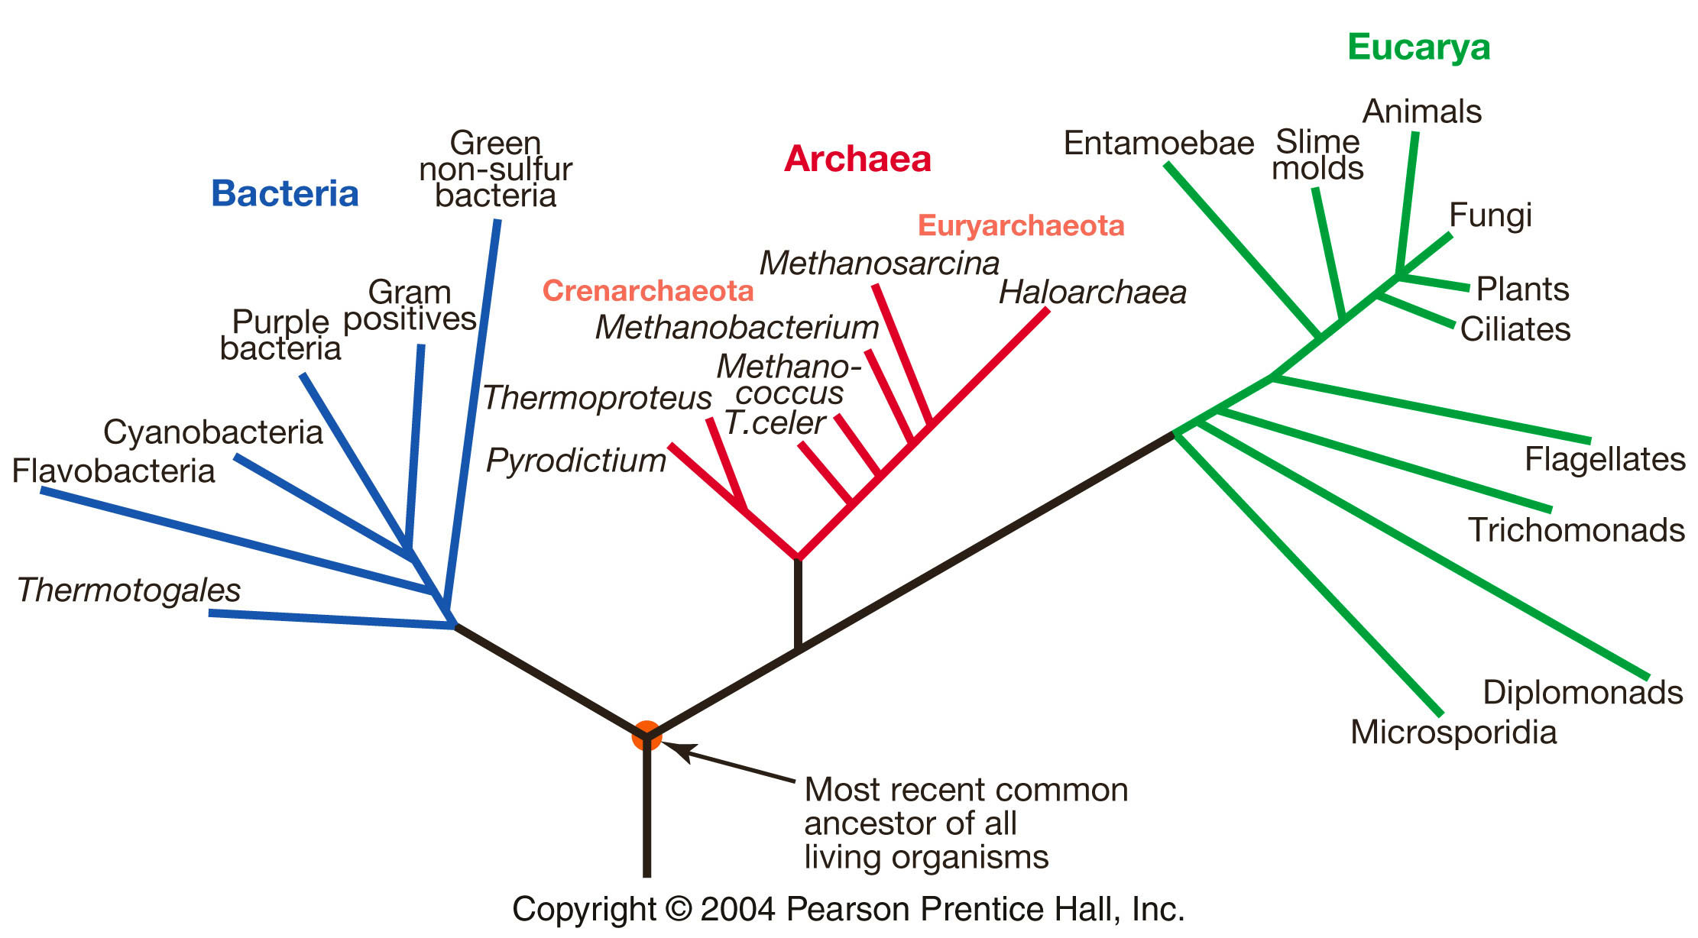
http://media.pearsoncmg.com/bc/bc_freeman_biosci_3/web_animations/tree_of_life/27_A01.swf
Rivera and Lake 2004
Notes:
Last common ancestor was likely a prokaryote (at least 2+ bya).
Possibly a fusion of bacterial and archaeal genomes to form first eukaryote.
Gene exchange was rampant.

Slide 4
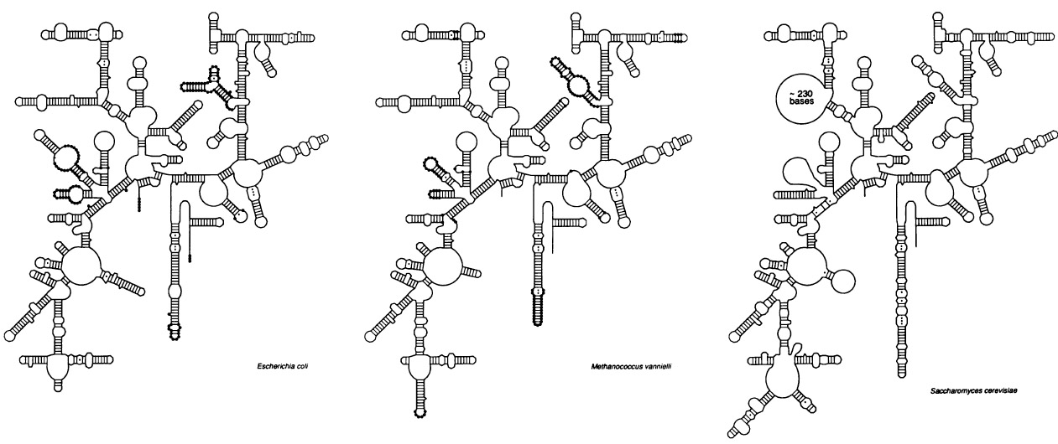
Structural diversity and similarity in ribosomal RNAs
bacteria
archaea
eukaryota
http://media.pearsoncmg.com/bc/bc_freeman_biosci_3/web_animations/tree_of_life/27_A01.swf
Woese 1987

Slide 5
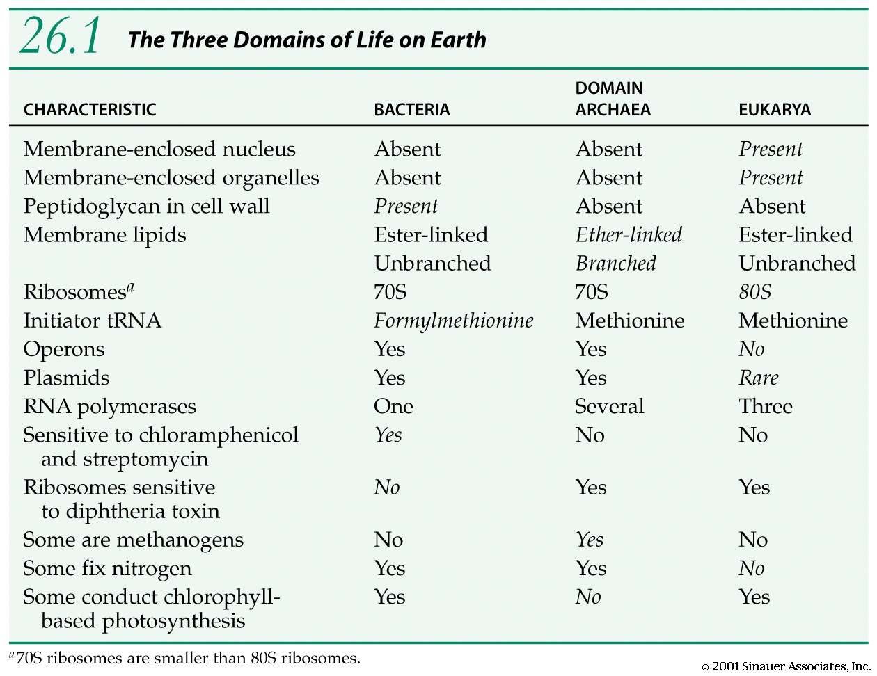

Slide 6
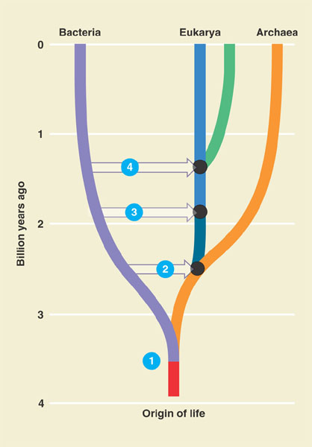
4 Symbiosis of chloroplast ancestor with ancestor of green plants
3 Symbiosis of mitochondrial ancestor with ancestor of eukaryotes
2 Possible fusion of bacterium and archaean, yielding ancestor of eukaryotic cells
1 Last common ancestor of all living things (LUCA)
Campbell & Reece 7th Edition, Fig. 25.18

Slide 7
Prokaryotic Lineage Diversity
At least 21 lineages of bacteria (we will describe just 6)
Firmicutes – Gram positive, anthrax, tetanus, strep, lactobacillus
Spirochaetes – syphilis, Lyme disease
Actinobacteria – tuberculosis, Swiss cheese, plant root nodules
Chlamydiae – chlamydia
Cyanobacteria – oxygenic photosynthesis!, some nitrogen fixing
Proteobacteria – cholera, food poisoning, plant root nodules, related to mitochondria
At least 4 lineages of Archaea (we will describe just 2)
Crenarchaeota – extremophiles, thought to be similar to the oldest archaeans
Euryarchaeota – extremely diverse metabolically and in habitat, some methanogens

Slide 8
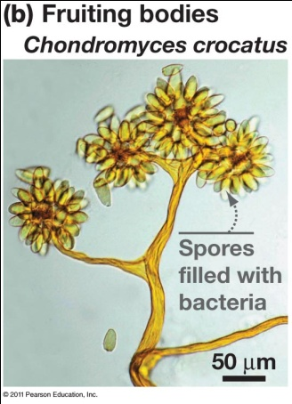
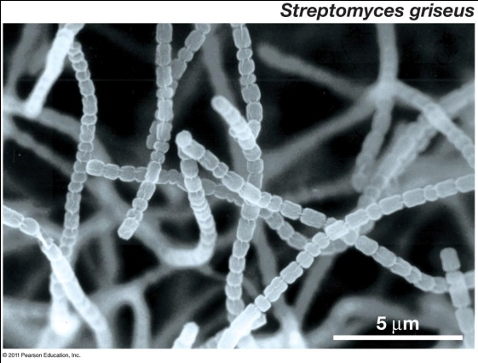
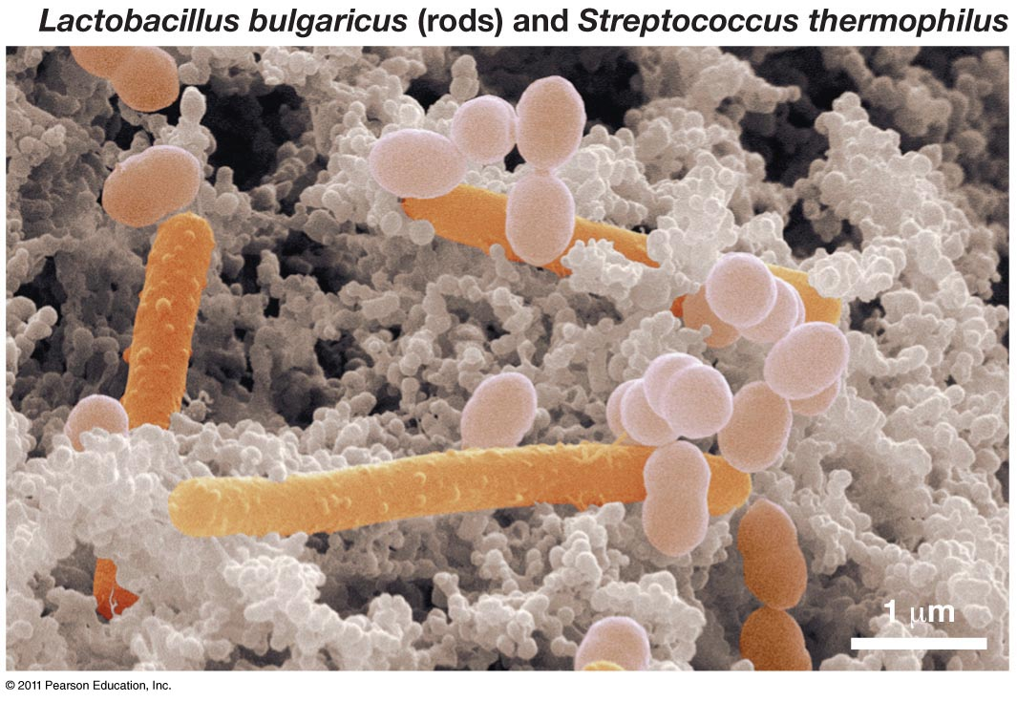
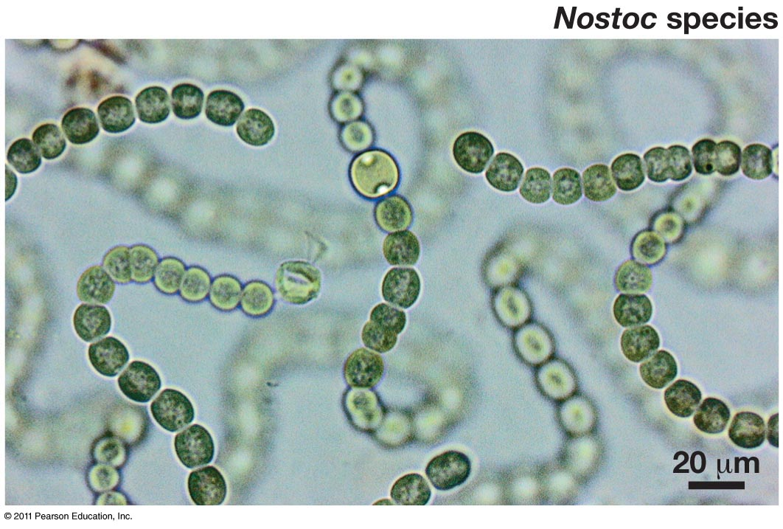
Prokaryote Diversity
Morphology
Metabolism
Habitats
Roles in medicine and bioremediation

Slide 9
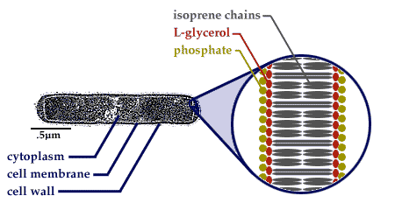
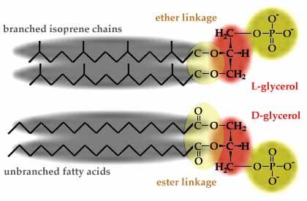
Morphology: Bacteria versus Archaea
Bacteria
Cell walls of peptidoglycan (thickness determines gram + or gram -)
Plasma membranes that are similar to eukarya
Distinct ribosomes and RNA polymerase
Archaea
Cell walls of polysaccharides
Unique plasma membranes (isoprene chains)
Ribosomes and RNA polymerase that are similar to eukarya
Shape: filaments, spheres,
rods, chains, spirals
Motility: flagella
http://www.ucmp.berkeley.edu/archaea/archaeamm.html

Slide 10
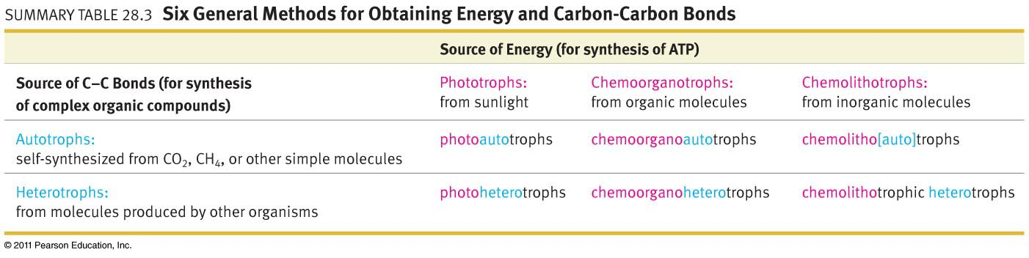
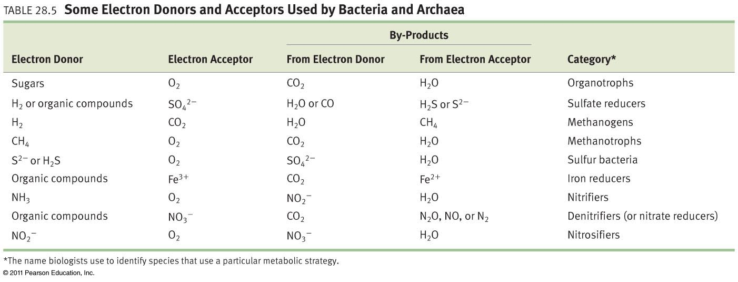

Slide 11
Gram Staining
Gram stain is a violet dye that can distinguish different types of bacteria
Gram-positive bacteria (pick up stain) have cell walls rich in peptidoglycan
Gram-negative bacteria do not
Mycoplasma (type of bacteria) lack cell walls and do not pick up Gram stain at all

Slide 12
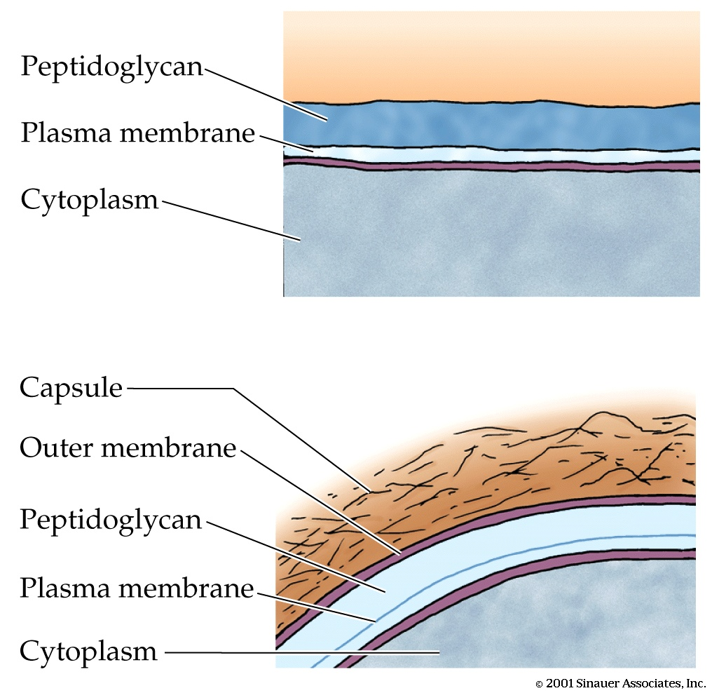
Gram positive bacteria
Gram negative bacteria

Slide 13
Metabolic classifications of organisms
All organisms are made of carbon (need a carbon source) and use ATP for energy (need a way to make ATP)
Classifications based on:
Source of energy (for synthesizing ATP)
Phototrophs–use light energy to generate ATP
Chemotrophs– use chemical bonds (e.g., glucose) as energy source for respiration or fermentation to generate ATP
Source of electrons (for synthesizing ATP)
Lithotrophs–oxidize (use as electron donors) inorganic molecules (water is the electron donor for oxygenic photosynthesis)
Organotrophs– oxidize (use as electron donors) organic molecules
Source of carbon (for synthesizing organic molecules)
Autotrophs– make their own organic molecules by reducing inorganic CO₂
Heterotrophs–require carbon in the form of organic molecules
Plants are photo(litho)autotrophs
Animals are chemoorganoheterotrophs
Only prokaryote are capable of the other four methods for producing ATP and carbon

Slide 14
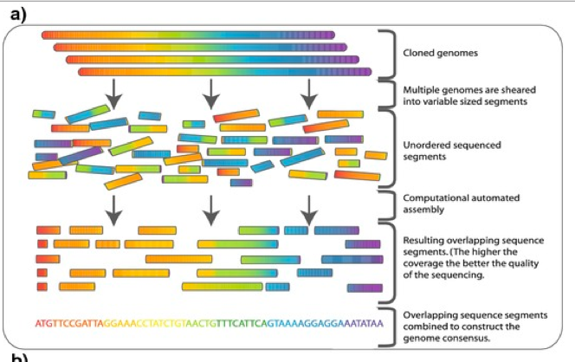
Techniques used to identify and quantify
Koch’s postulates → Germ theory of disease
Enrichment cultures
DNA sequencing: 16s rRNA
Shotgun sequencing →
Notes:
Koch’s postulates:
Microbe present in individuals suffering from disease, absent in healthy indiv
Microbe is isolated and grown in culture.
Microbe is used to infect new indiv, symptoms appear.
Microbe is isolated from new patient, cultured, and looks identical to #2.
Germ theory – microbes cause infectious diseases. Led to improvements in sanitation, reducing mortality.

Slide 15
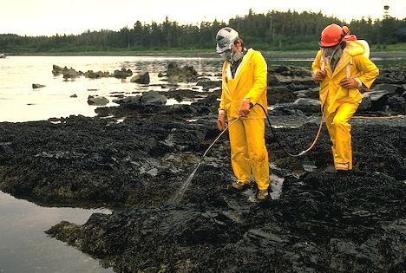
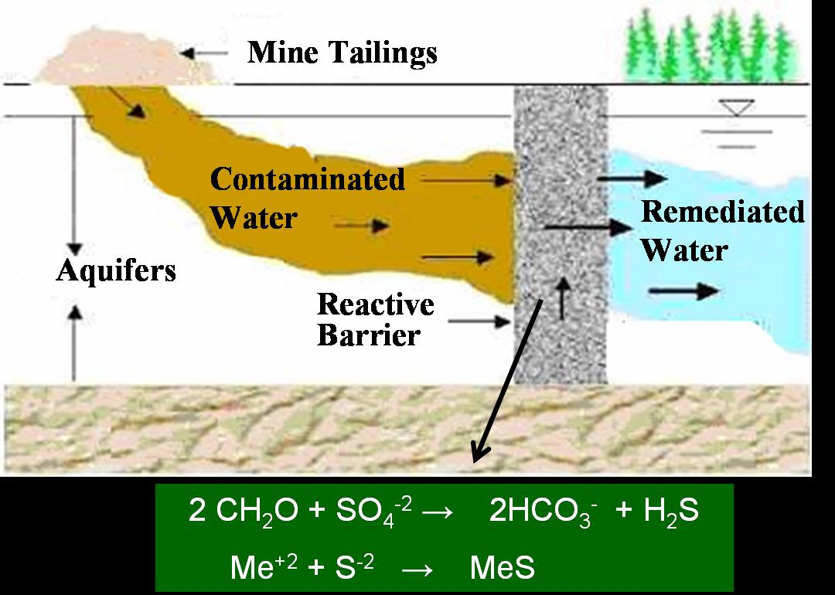
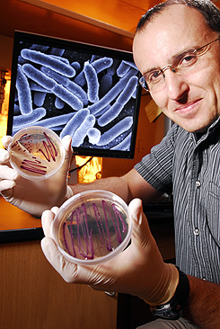
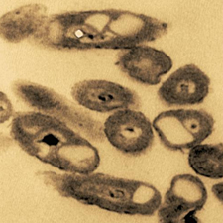
Bioremediation: cleaning up with prokaryotes
Acid mine drainage
https://www.engr.colostate.edu/~apruden/Research%20Group/Projects/Acid%20Mine%20Drainage.htm
Bioremediation involves:
Fertilizing area
Seeding area
http://www.scientificamerican.com/article.cfm?id=how-microbes-clean-up-oil-spills
http://gtresearchnews.gatech.edu/newsrelease/bioremediation-diversity.htm
Notes:
Right: Alaska. Workers outfitted in safety attire spray benign nutrients for Bioremediation Project on the Exxon Valdez oil spill in Prince William Sound.
R, bottom: Dr. Kostas Kostantinidis at GT explores how different strains of a single bacterial species, Shewanella, can reduce metals. His research highlights how specific strains of microbes could be used in bioremediation.
Left. Area on left was treated with bioremediating bacteria to clean up oil. Exxon-Valdez oil spill.
L, bottom: Alcanivorax borkumensis, a potential player in bioremediation of Deepwater Horizon Oil Spill. These microbes break down hydrocarbons, harvest energy and release CO2. Aerobic, so when oxygen is depleted the process of oil degradation slows dramatically. Fertilizing works well on shore, where nutrients stick to soils and remain available for bacterial use. Not effective in open ocean. Some feel the dispersants are helpful because breaks oil up into smaller, more easily consumed droplets, but others worry about the carcinogenic effects of a solvent in the dispersant used in the Gulf.

Slide 16
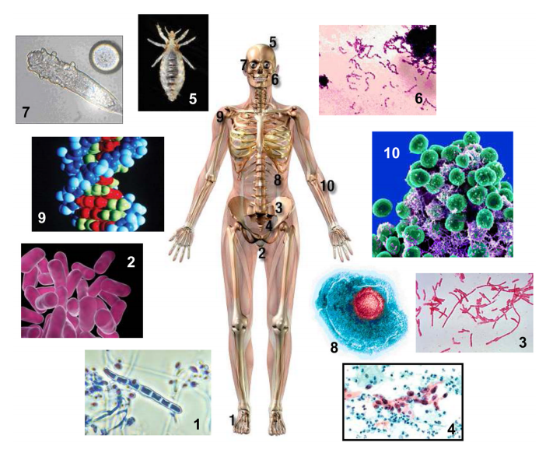
The human microbiome
(Unlike Darth Vader) we are more microbe than man:
Bacteria far outnumber human cells in & on the body >10:1
Bacterial genes outnumber human genes >100:1
Medical treatments for disease can include probiotic therapy
Immunostimulation and immunosuppression properties
Hsieh & Versalovic 2008
Notes:
Figure 1. The human super-organism
Adapted from Glausiusz, Discover Magazine, June 2007, as well as images courtesy of the
National Institutes of Health, National Cancer Institute, Centers for Disease Control, and
Wikipedia. This figure depicts different microbes and other organisms that have been
intimately associated with humans as commensals or potential pathogens. The numbers
correspond to images of organisms and approximate anatomic locations where these organisms
may reside on the human body. 1.Trichophyton and Epidermophyton are filamentous, parasitic
microbes that cause athlete’s foot. 2. Vaginal microbiota, mostly Lactobacillus species secrete
lactic acid and other antimicrobial compounds that prevent pathogen overgrowth. 3. More than
500 species of bacteria, weighing approximately 3.3 pounds in the average human adult, live
inside the gastrointestinal tract. 4. More than 100 strains of human papillomavirus (HPV) can
infect humans, causing a variety of warts from the common wart to plantar and flat warts. 5.
Pediculus humanus capitis, the head louse, may have co-evolved with recent H. sapiens. 6.
Oral Streptococcus species form biofilms that may be 300–500 cells in thickness on the surfaces
of unbrushed teeth. 7. Demodex mites inhabit the follicles of the eyelashes and infest about 20
percent of people under the age of 20. 8. After initial infection with the varicella-zoster virus
(chickenpox), the virus remains dormant in nerve ganglia and may cause disease due to re-
activation later in life. 9. Approximately 1/12 of the human genome consists of DNA from
fossil viruses that infected human ancestors millions of years ago. 10. Prevalent bacterial genera
on the human skin include Streptococcus, Staphylococcus, and Corynebacterium.

Slide 17
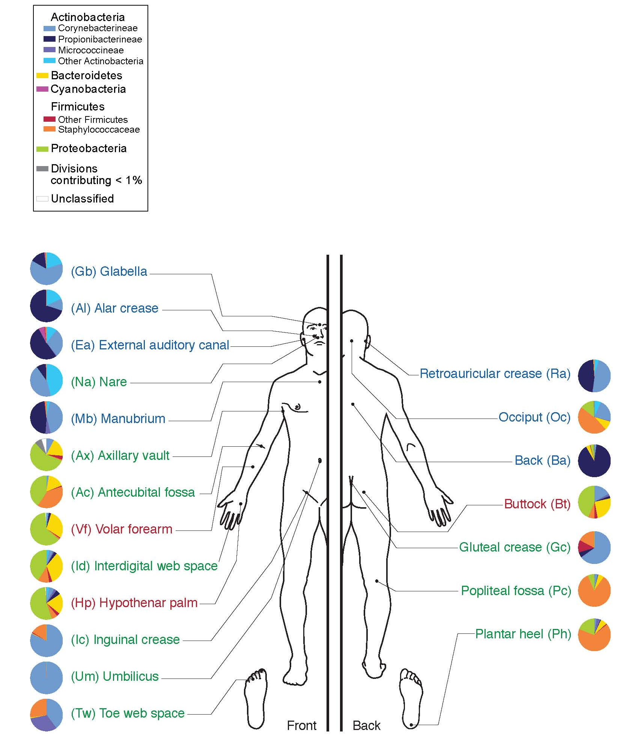
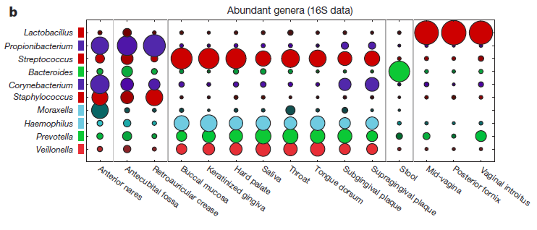
Human Microbiome Project 2012
Notes:
HMP Consortium, Nature 14 June 2012.

